Slide 1

<? echo
“The PHP Contributor Roadmap”;
?>
by Juan Carlos Morales

Slide 2



Who am I?
Juan Carlos Morales
Software Engineer
juan-morales
jcm-jcm

Slide 3
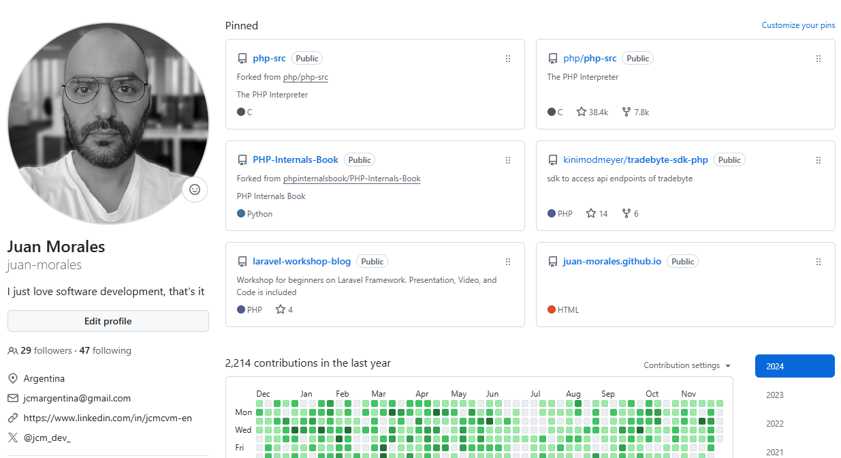
Who am I?

Slide 4
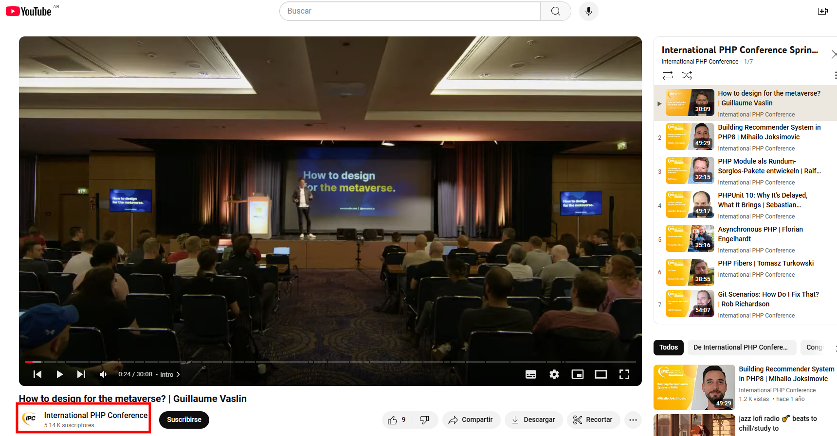
History
It was year 2022, at the IPC (International PHP Conference) in Berlin, Germany.

Slide 5
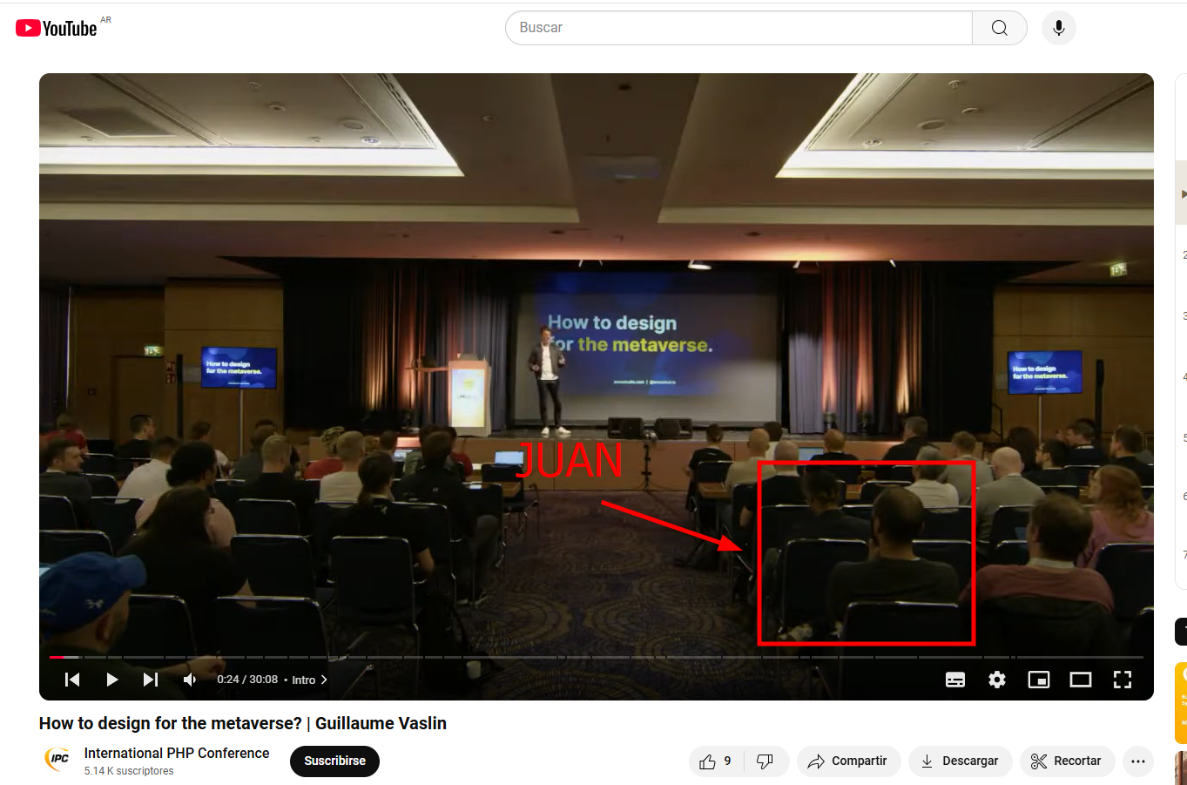
History
It was year 2022, at the IPC (International PHP Conference) in Berlin, Germany.

Slide 6
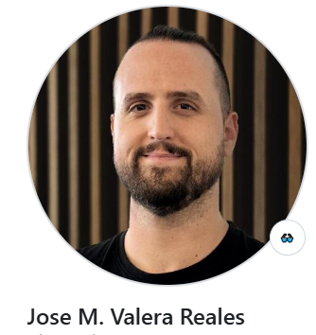
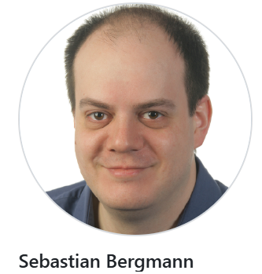
History
It was year 2022, at the IPC (International PHP Conference) in Berlin, Germany.

Slide 7
What is this presentation about?
This presentation will try to give you a better understanding about different ways someone can contribute to the PHP Project, specially by coding
Will provide online resources to learn about
Instructions to setup your local environment
Roadmap made by experience to contribute to the code of PHP, the way I made it!

Slide 8
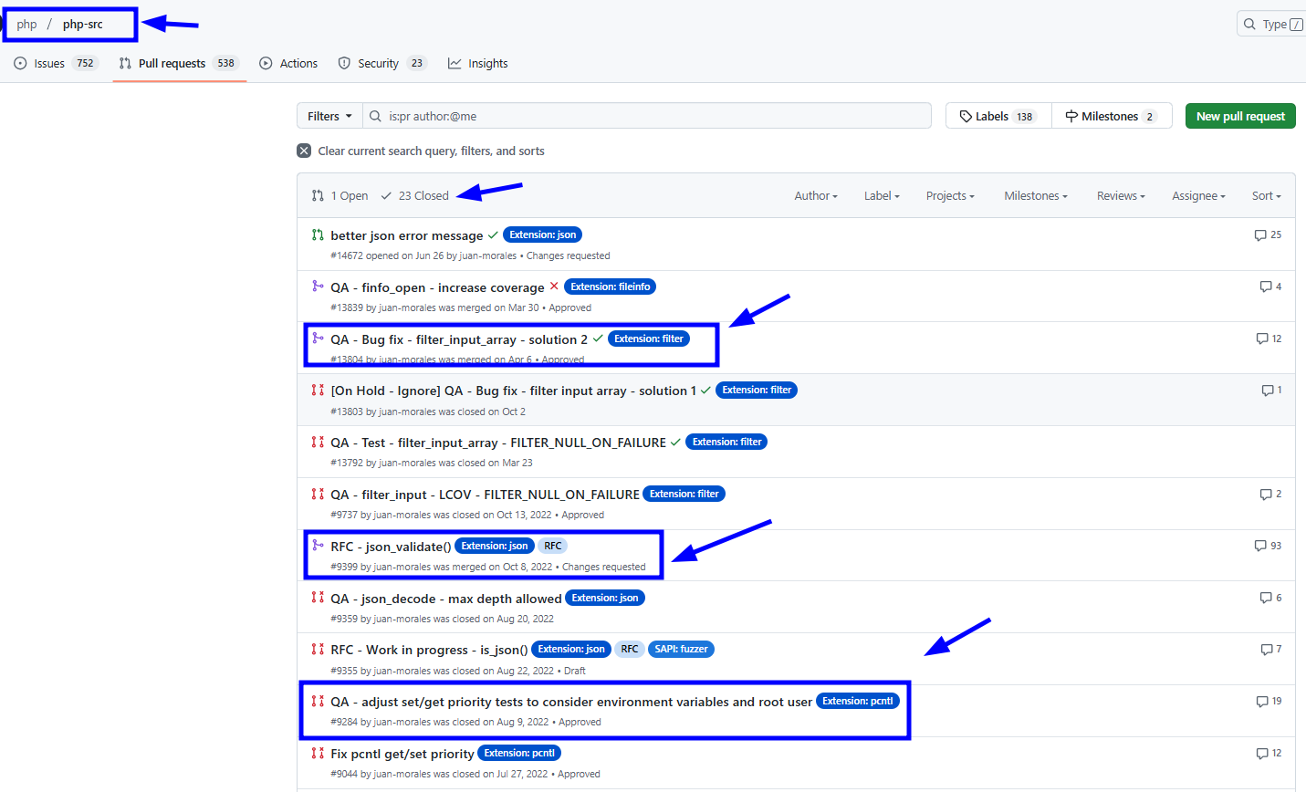
My PHP contributions

Slide 9
Roadmap to start contributing to the code of PHP
1
Join the community
2
Read contributor information
Always
3
Setup local environment
Read the existing documentation and learn from it, while walking the roadmap
4
Learn PHP Tests (PHPT)
5
Fix a bug
6
Deep Dive into PHP Internals
6.1
Make an RFC
6.2
Write an Extension

Slide 10
Roadmap to start contributing to the code of PHP
1
Join the community
Always
Read the existing documentation and learn from it, while walking the roadmap

Slide 11
Roadmap: 1 Join the Community
Joining the community is the first step.
Will help you to put yourself into the radar of “what is going on at the moment?”.
You will put yourself up-to-date with the actual discussions related to features, changes, RFCs, etc.
Also, if in the future you work in an RFC or new extension, you will need to be in touch with the community, either because of help, or in the case of RFCs you need to discuss it with the Community as part of the procedure.

Slide 12
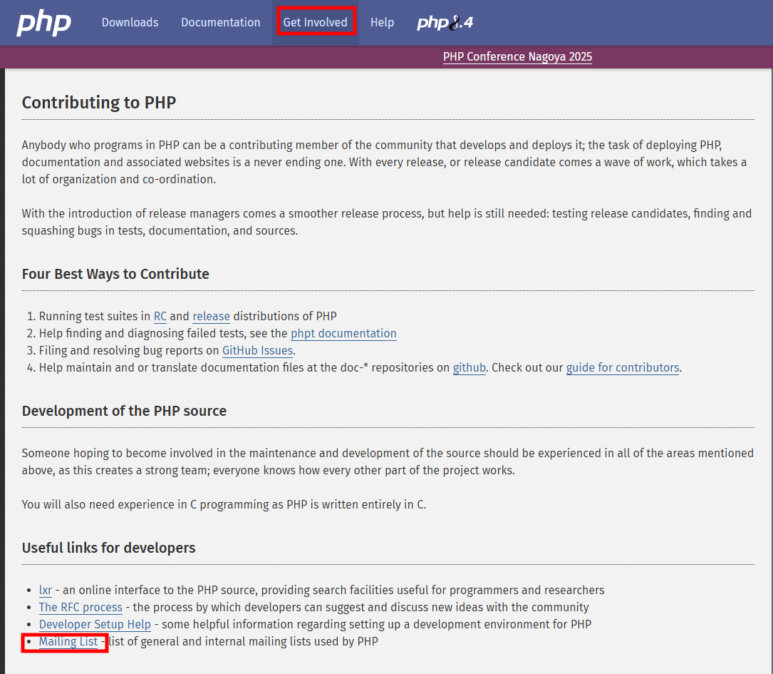
Roadmap: 1 Join the Community - Internals Mailing List

Slide 13
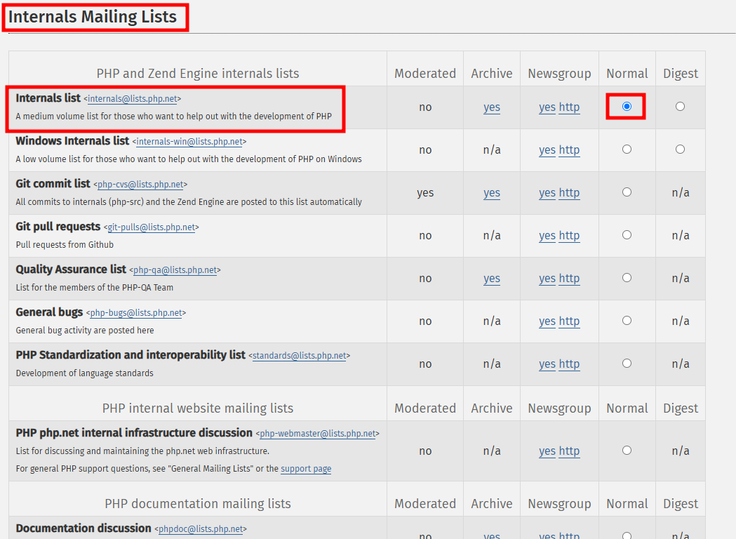
Roadmap: 1 Join the Community - Internals Mailing List

Slide 14
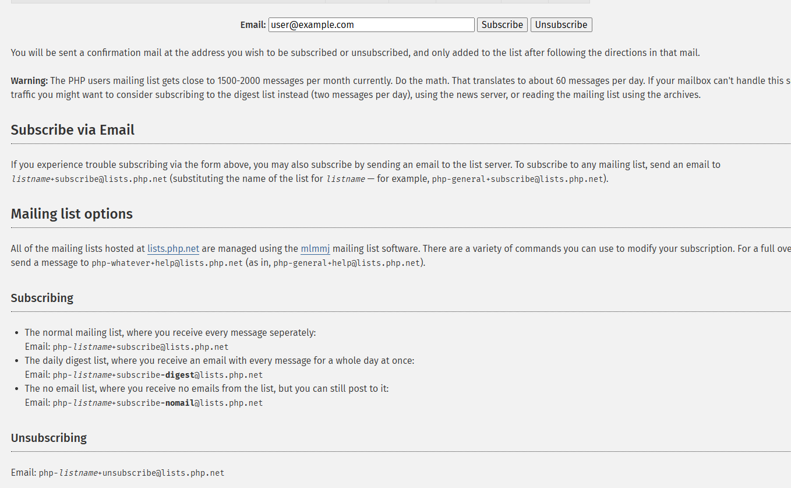
Roadmap: 1 Join the Community - Internals Mailing List

Slide 15
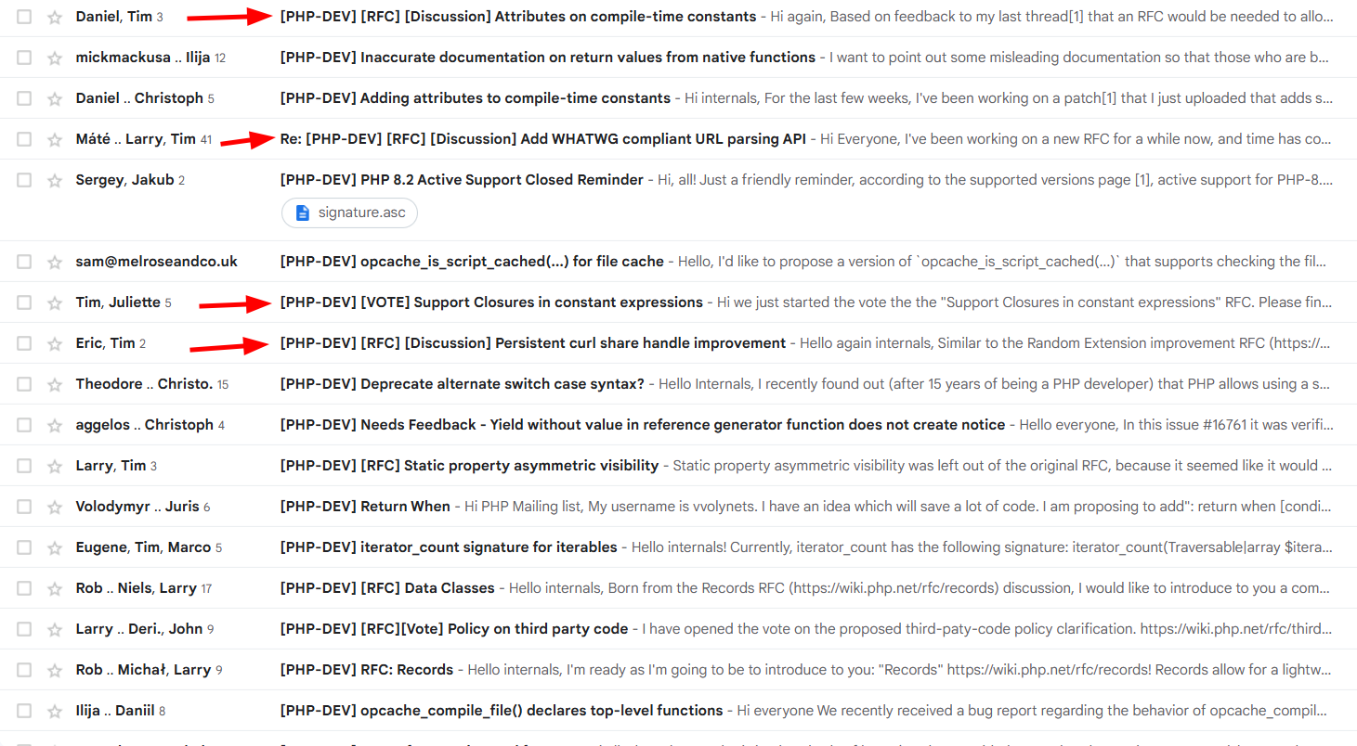
Roadmap: 1 Join the Community - Internals Mailing List

Slide 16
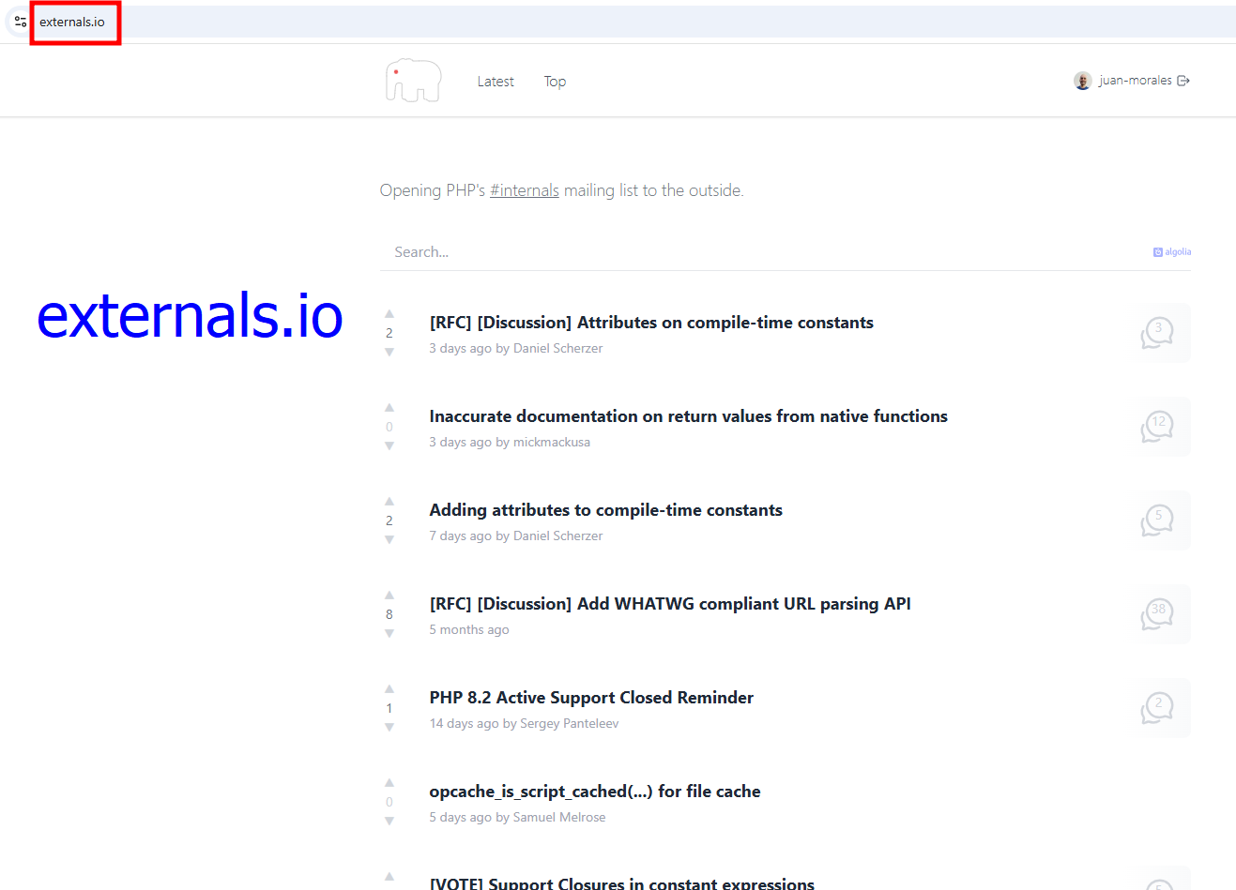
Roadmap: 1 Join the Community - Mailing List

Slide 17
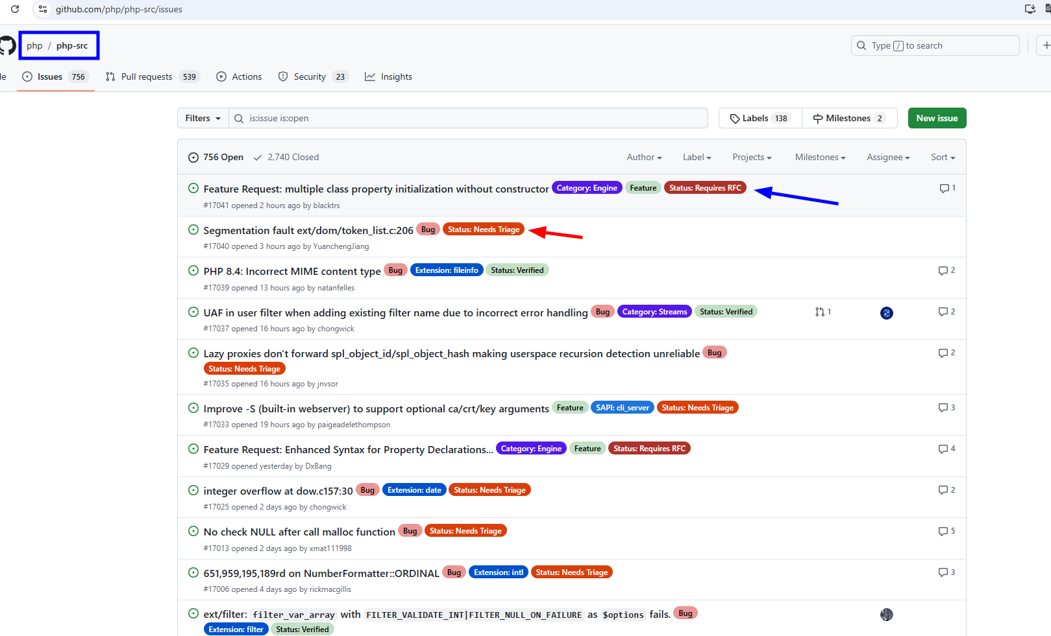
Roadmap: 1 Join the Community - Github

Slide 18
Roadmap to start contributing to the code of PHP
1
Join the community
2
Read contributor information
Always
Read the existing documentation and learn from it, while walking the roadmap

Slide 19
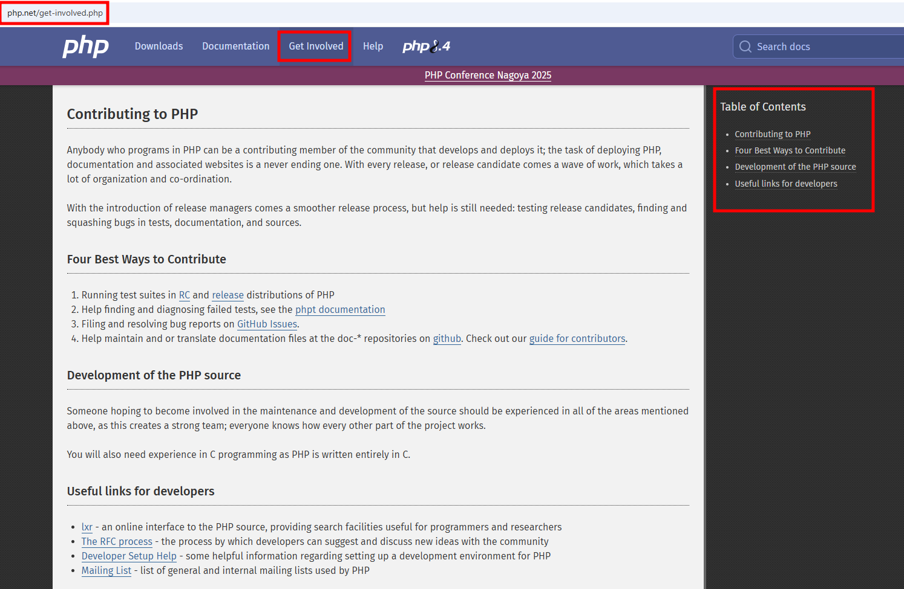
Roadmap: 2 Read the contributor information

Slide 20
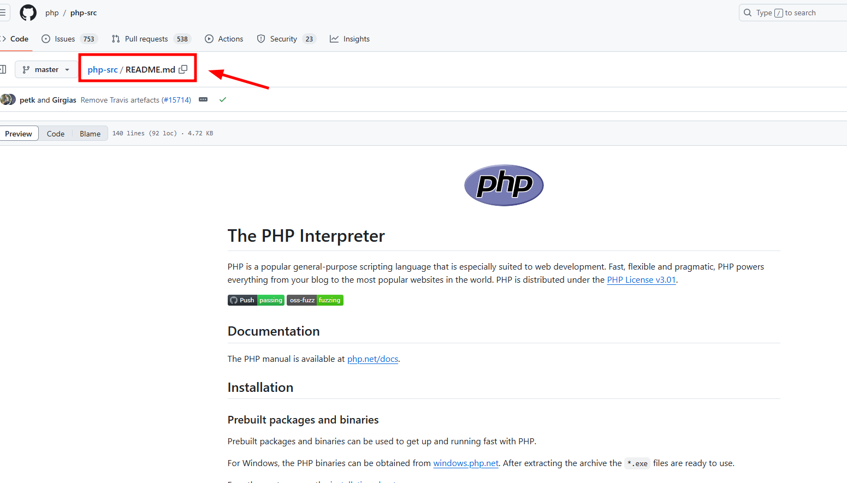
Roadmap: 2 Read the contributor information

Slide 21
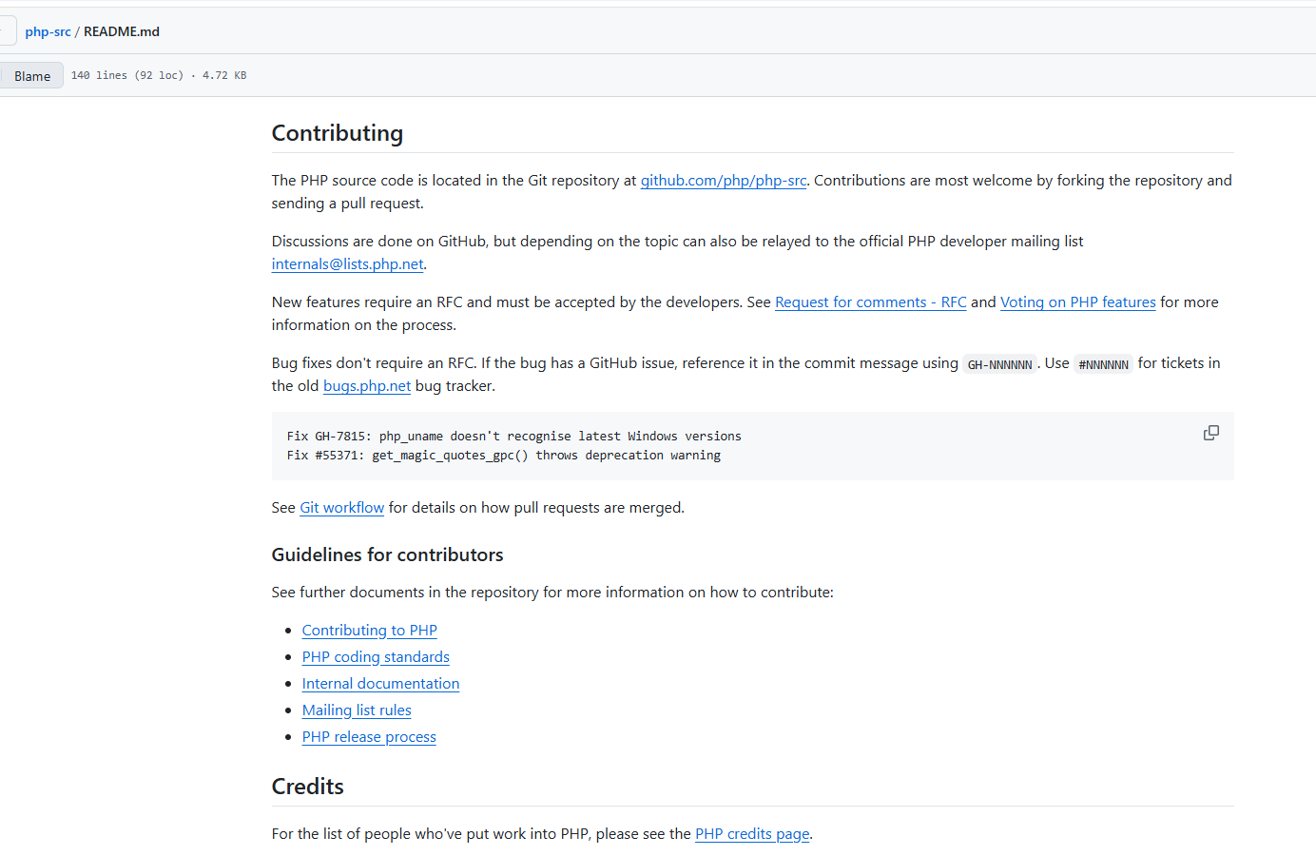
Roadmap: 2 Read the contributor information

Slide 22
Roadmap to start contributing to the code of PHP
1
Join the community
2
Read contributor information
Always
3
Setup local environment
Read the existing documentation and learn from it, while walking the roadmap

Slide 23
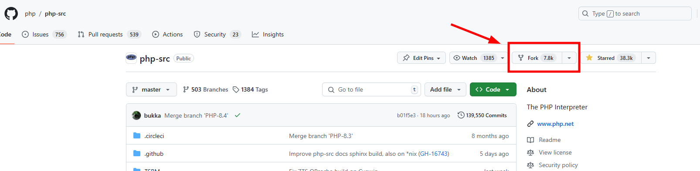
Roadmap: 3 Setup your local environment
Fork the php-src repository

Slide 24
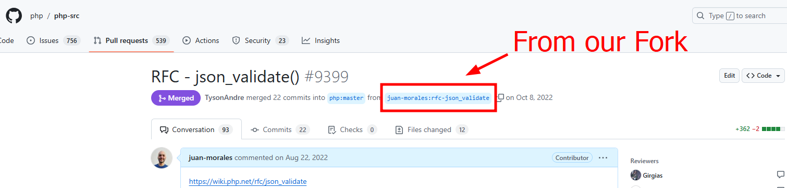
Roadmap: 3 Setup your local environment
Fork the php-src repository

Slide 25
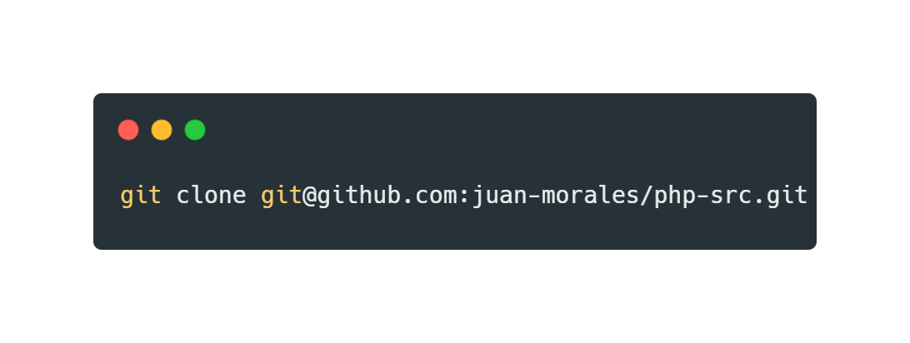
Roadmap: 3 Setup your local environment
Clone your fork locally in your development machine

Slide 26
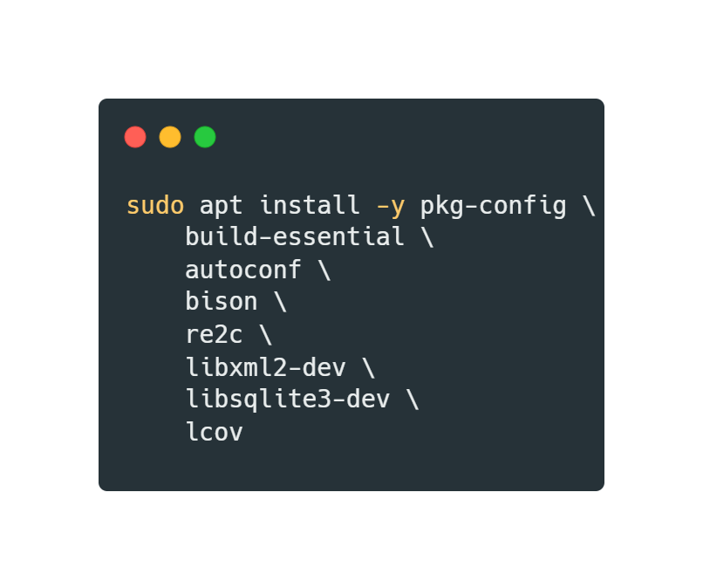
Roadmap: 3 Setup your local environment
Install development requirements and dependencies

Slide 27
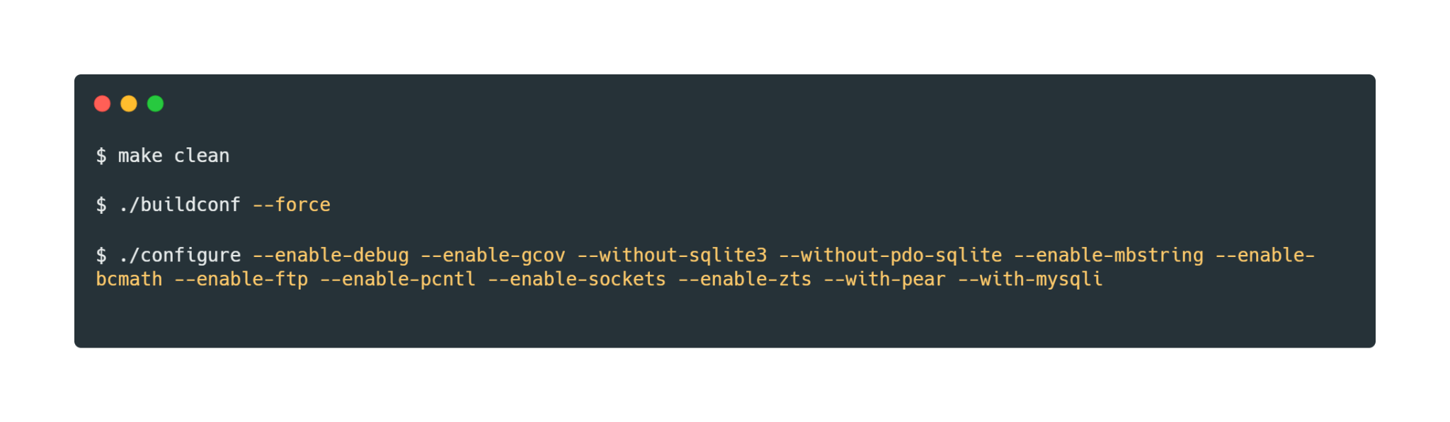
Roadmap: 3 Setup your local environment
Configure and Build PHP from source code

Slide 28
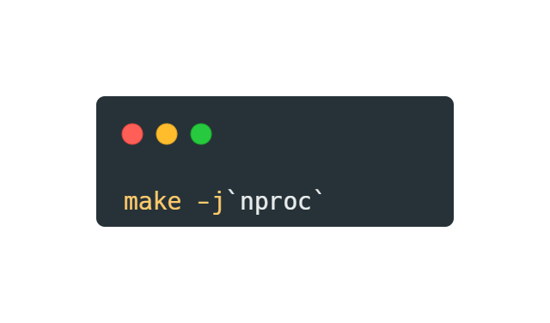
Roadmap: 3 Setup your local environment
Configure and Build PHP from source code

Slide 29
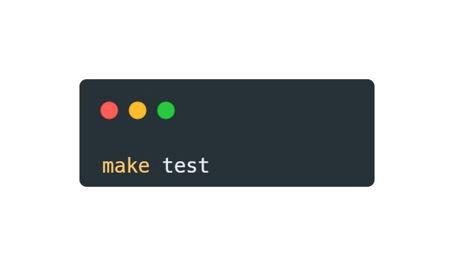
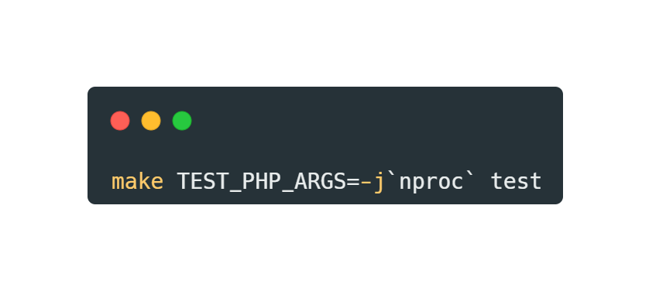
Roadmap: 3 Setup your local environment
Run the PHP Tests

Slide 30
Roadmap: 3 Setup your local environment
…
All Set!

Slide 31
Roadmap to start contributing to the code of PHP
1
Join the community
2
Read contributor information
Always
3
Setup local environment
Read the existing documentation and learn from it, while walking the roadmap
4
Learn PHP Tests (PHPT)

Slide 32
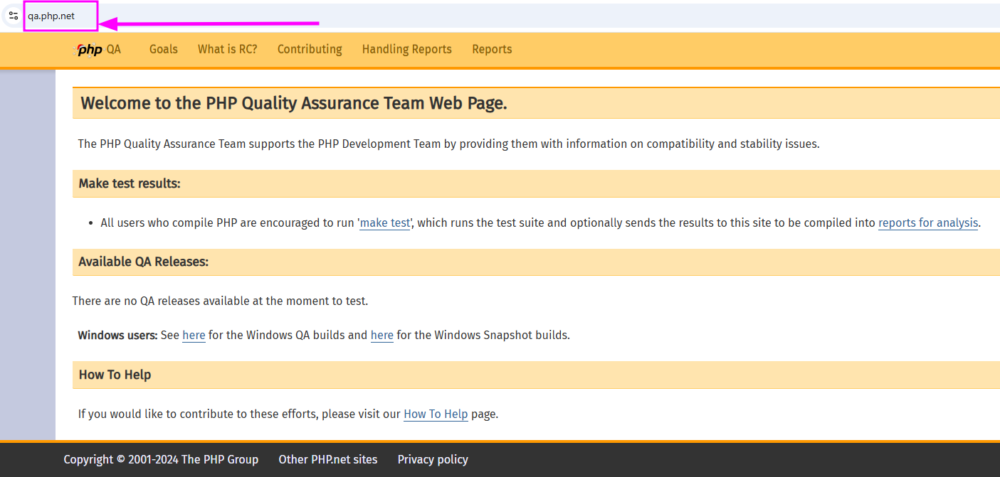
Roadmap: 4 Learn PHP Tests - PHPT
Official documentation

Slide 33
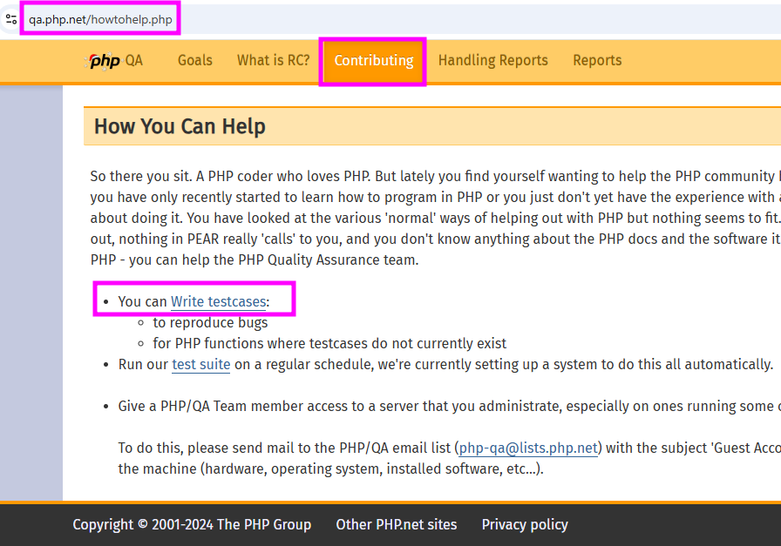
Roadmap: 4 Learn PHP Tests - PHPT
Official documentation

Slide 34
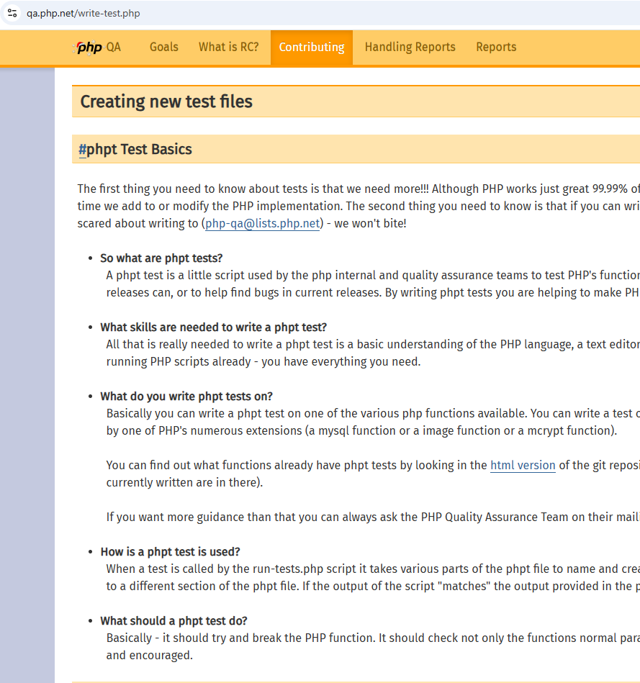
Roadmap: 4 Learn PHP Tests - PHPT
Official documentation

Slide 35
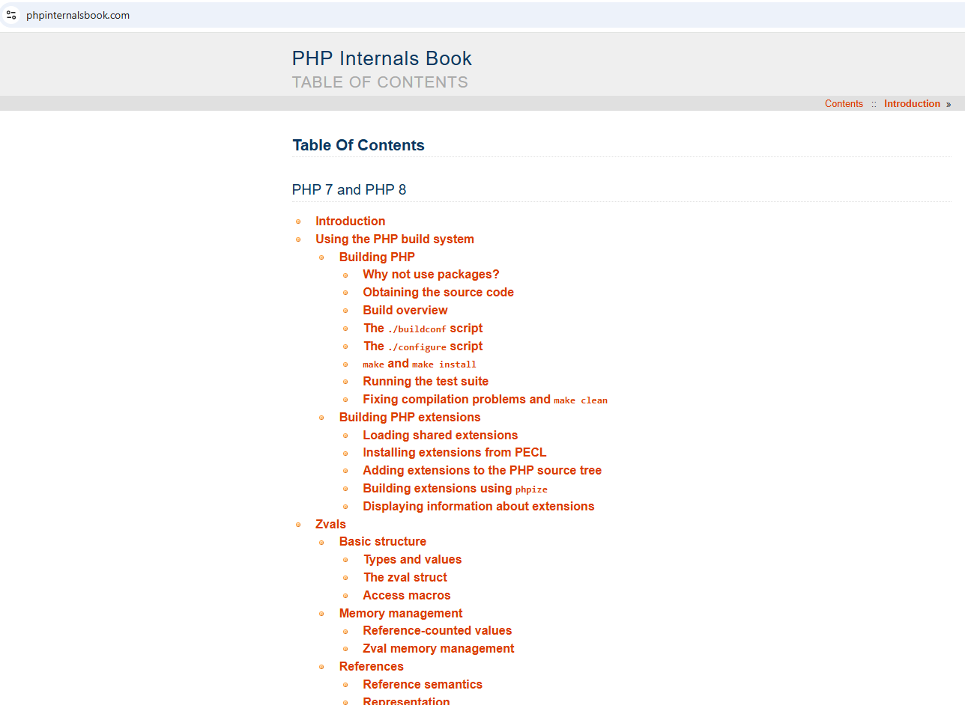
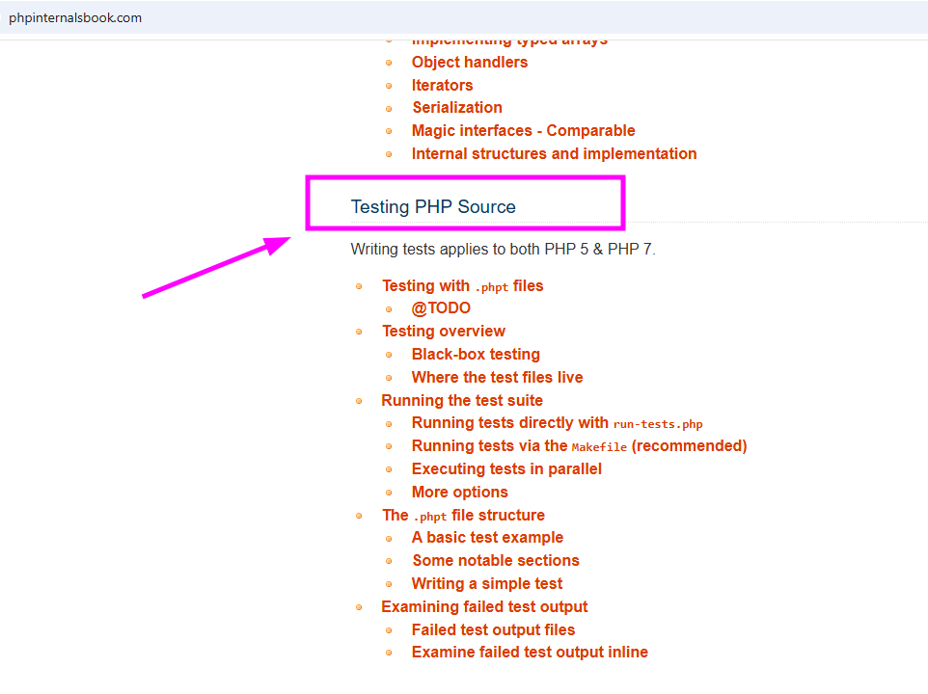
Roadmap: 4 Learn PHP Tests - PHPT
PHP Internals Book

Slide 36
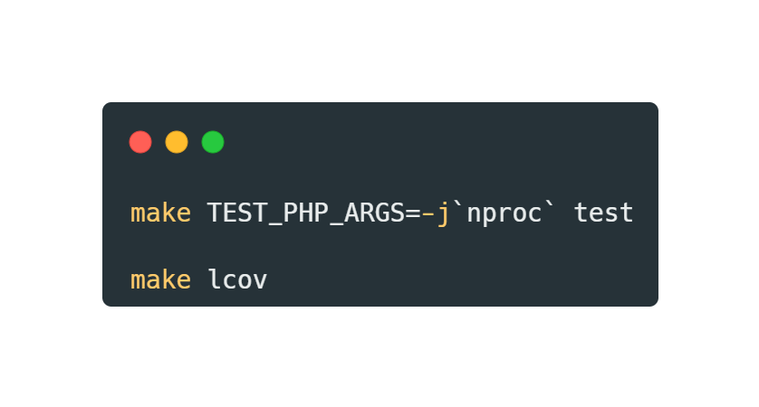
Roadmap: 4 Learn PHP Tests - PHPT
Write a QA Test to increase source code test coverage
Then check in folder lcov_html the file index.html

Slide 37
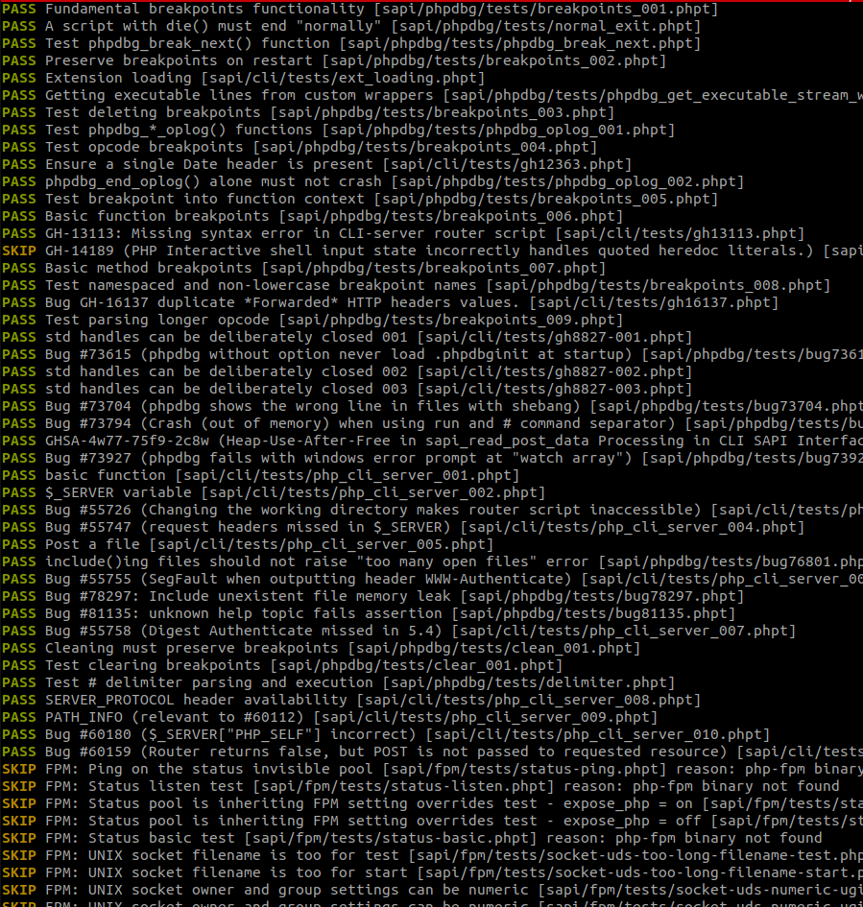
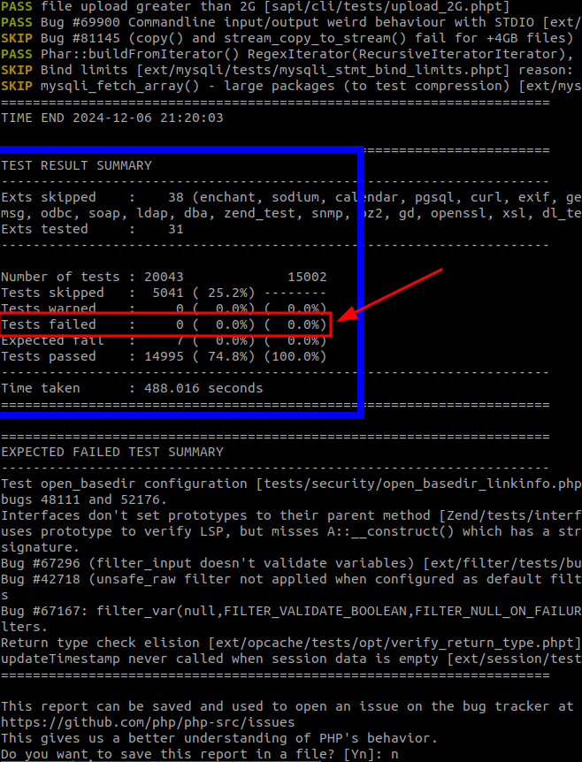
Roadmap: 4 Learn PHP Tests - PHPT
Write a QA Test to increase source code test coverage

Slide 38
Roadmap: 4 Learn PHP Tests - PHPT
Write a QA Test to increase source code test coverage

Slide 39
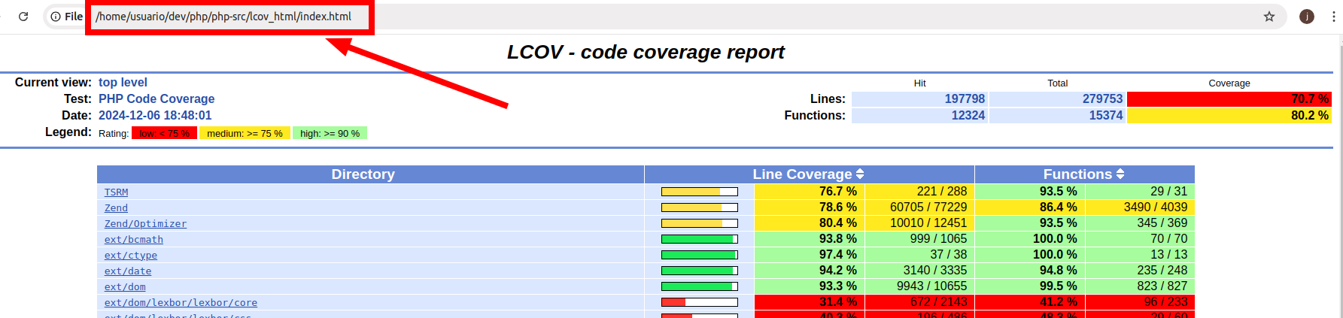
Roadmap: 4 Learn PHP Tests - PHPT
Write a QA Test to increase source code test coverage
Results may vary depending on how PHP was configured while building it. (the ./configure part)

Slide 40
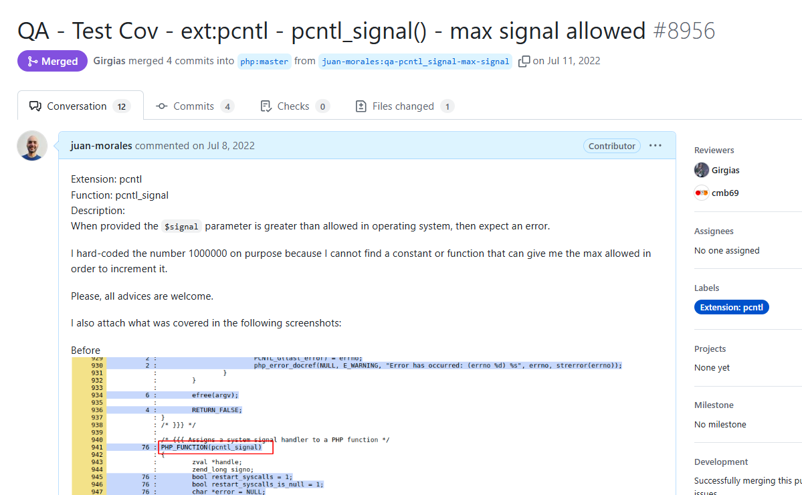
Roadmap: 4 Learn PHP Tests - PHPT
Example

Slide 41
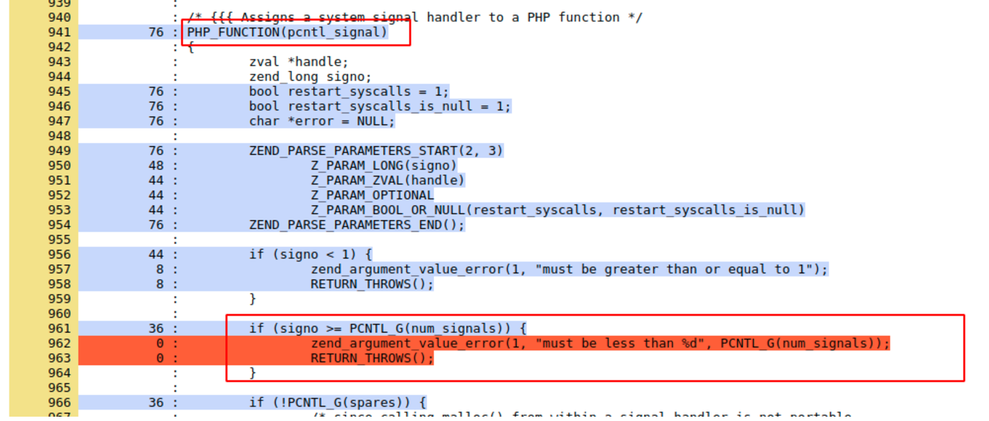
Roadmap: 4 Learn PHP Tests - PHPT
Example

Slide 42
Roadmap: 4 Learn PHP Tests - PHPT
Example
name of a userland php function, because of PHP_FUNCTION()
some variables
parsing parameters
if parameter “signo” is bigger than “max allowed” we inform “that“ and returns

Slide 43
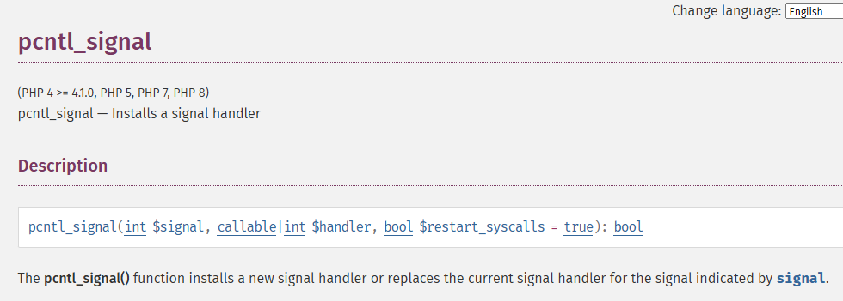
Roadmap: 4 Learn PHP Tests - PHPT
Example

Slide 44
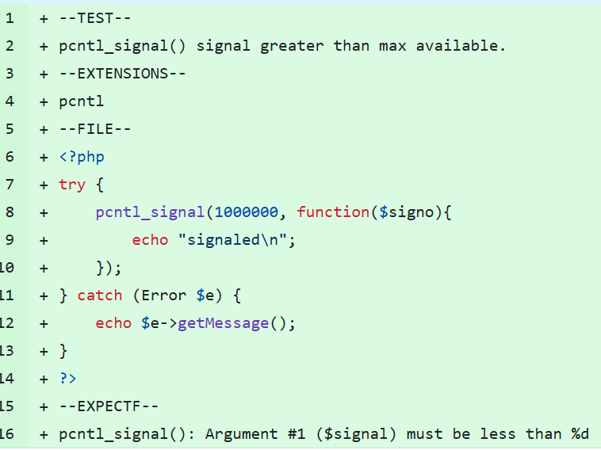
Roadmap: 4 Learn PHP Tests - PHPT
Example
;-)

Slide 45
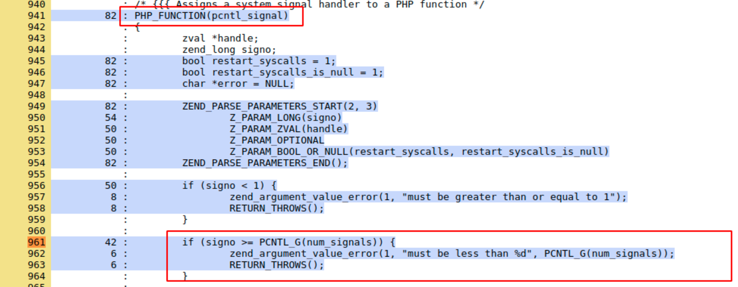
Roadmap: 4 Learn PHP Tests - PHPT
Example

Slide 46
Roadmap: 4 Learn PHP Tests - PHPT
Example
Include all information possible in your pull request and provide coverage before and after your test
Did you read my comment in the example? Nice idea for an RFC right? ;)
Nice opportunity to enhance the documentation right? :D
According to my experience writing coverage (QA) tests is a smooth way to learn about PHPs internals

Slide 47
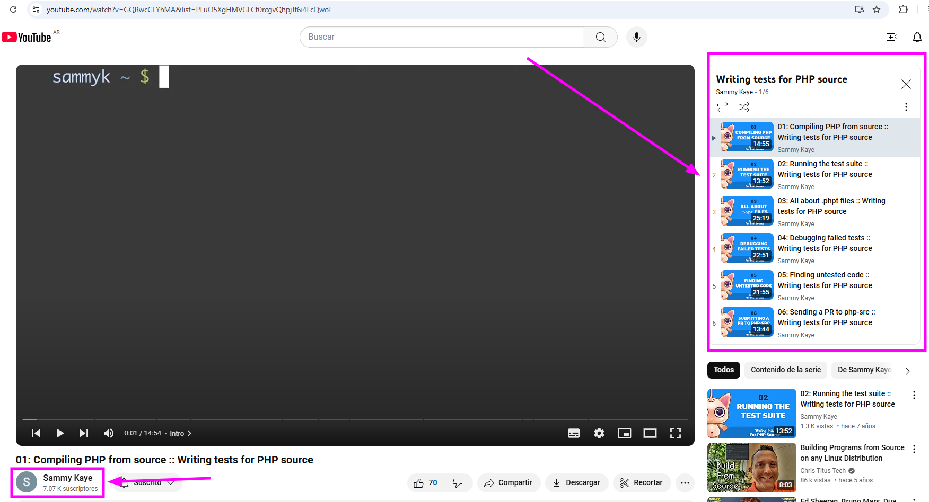
Roadmap: 4 Learn PHP Tests - PHPT
Nice tutorial by Sammy Kaye on YouTube

Slide 48
Roadmap: 4 Learn PHP Tests - PHPT
Writing QA Tests will give you confidence and better understanding of what you read in documentation related to PHP´s internals
Your will move through the source code with more knowledge about it
In order to understand how the test should be written in order to cover PHP’s C code, you need to understand what the C code is doing, in order to check how to cover that code from a PHP script. This process accelerates the learning process of PHP Core Code and gives better understanding of related documentation

Slide 49

Roadmap: 4 Learn PHP Tests - PHPT
Want to write a test ? :D

Slide 50
Roadmap: 4 Learn PHP Tests - PHPT
a question …
What could happen while writing tests for uncovered code ?

Slide 51
Roadmap to start contributing to the code of PHP
1
Join the community
2
Read contributor information
Always
3
Setup local environment
Read the existing documentation and learn from it, while walking the roadmap
4
Learn PHP Tests (PHPT)
5
Fix a bug

Slide 52
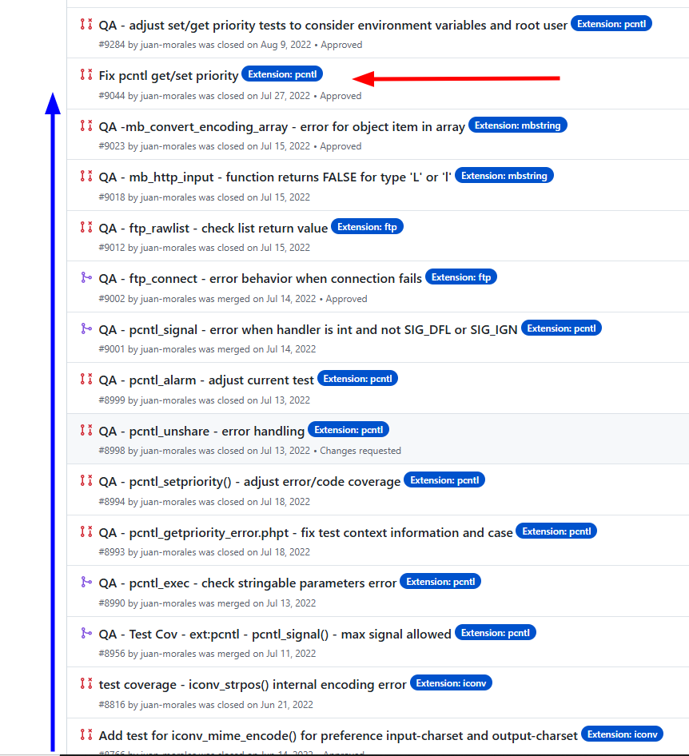
Roadmap: 5 Fix a bug
Overview
While writing test for uncovered code, could be that you discover a bug ;)

Slide 53
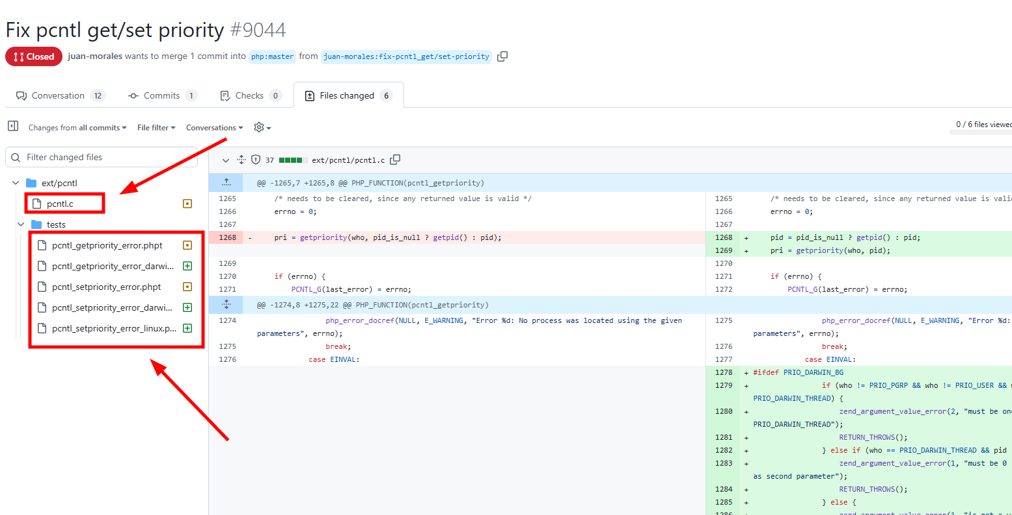
Roadmap: 5 Fix a bug
Overview

Slide 54
Roadmap: 5 Fix a bug
Overview
Little bit of C
And many tests :D

Slide 55
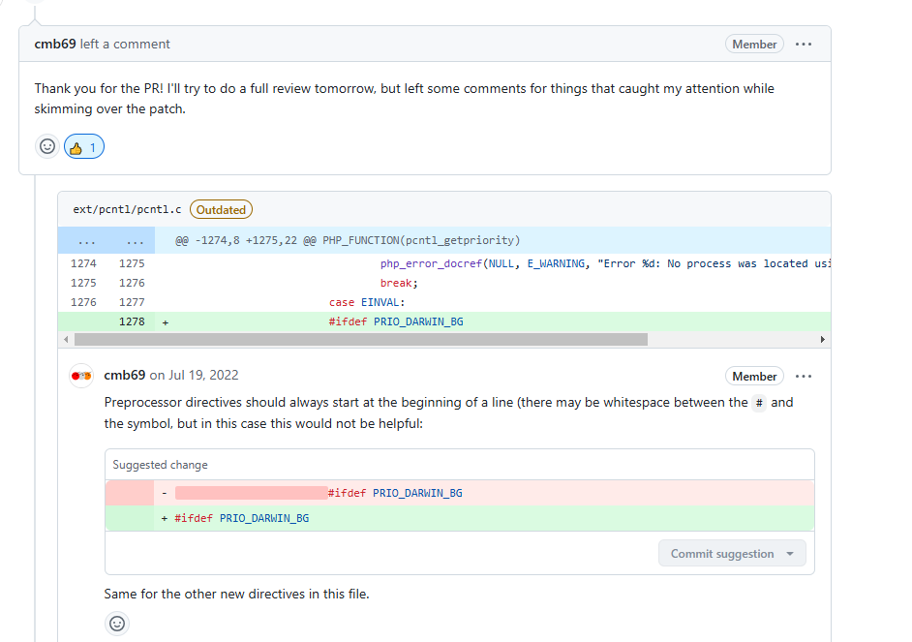
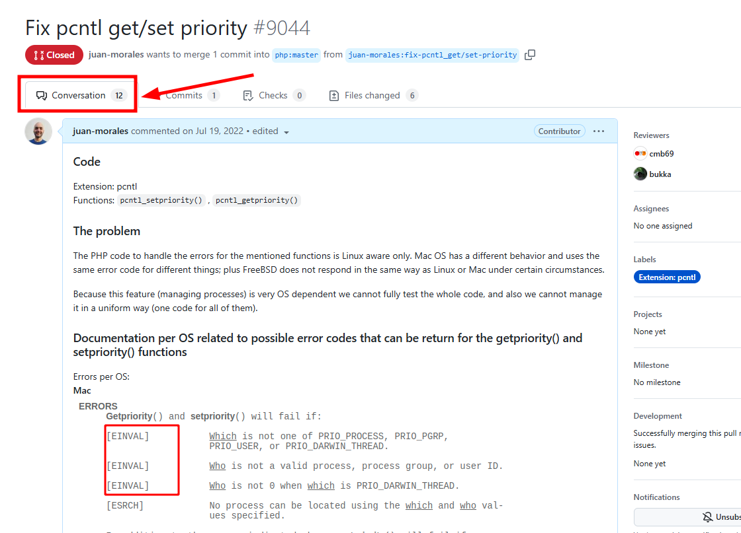
Roadmap: 5 Fix a bug
Overview

Slide 56
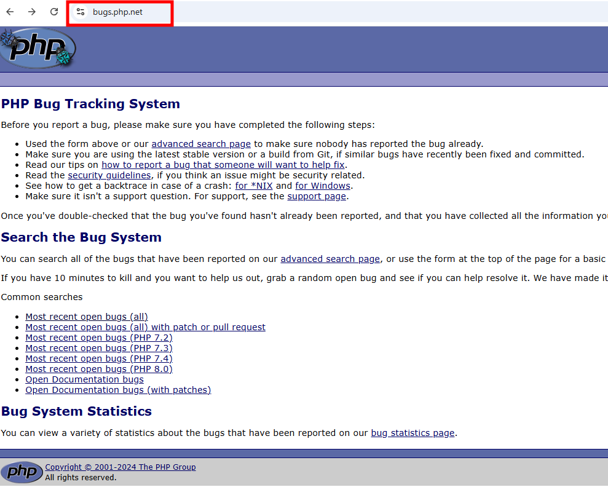
Roadmap: 5 Fix a bug
Where to look for bugs?

Slide 57
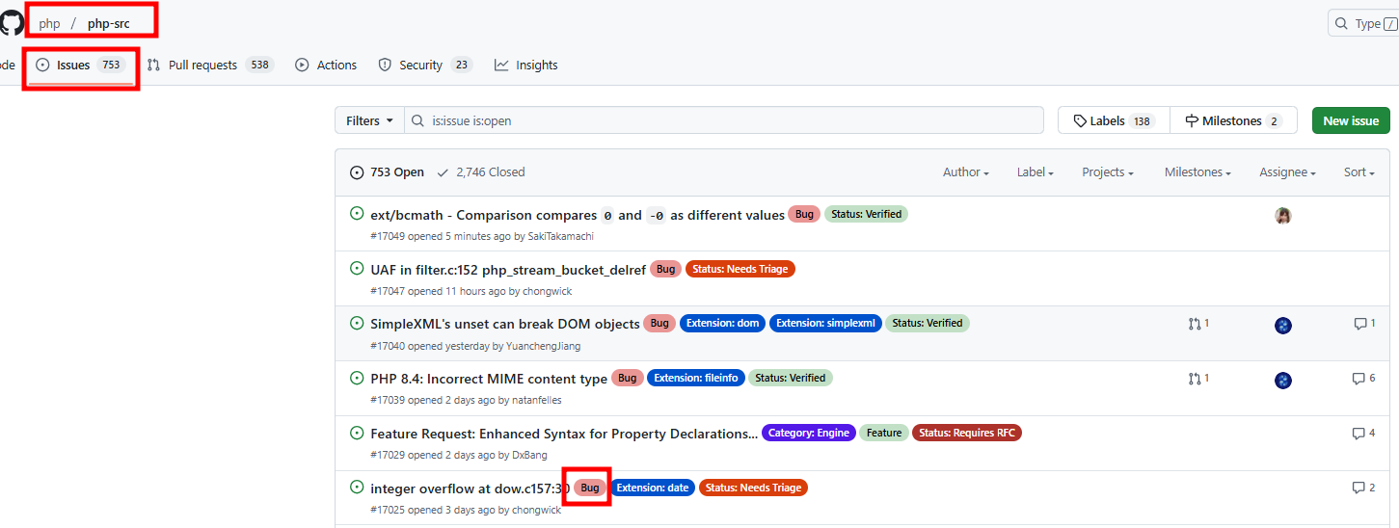
Roadmap: 5 Fix a bug
Where to look for bugs?

Slide 58
Roadmap to start contributing to the code of PHP
1
Join the community
2
Read contributor information
Always
3
Setup local environment
Read the existing documentation and learn from it, while walking the roadmap
4
Learn PHP Tests (PHPT)
5
Fix a bug
6
Deep Dive into PHP Internals
6.1
Make an RFC
6.2
Write an Extension

Slide 59
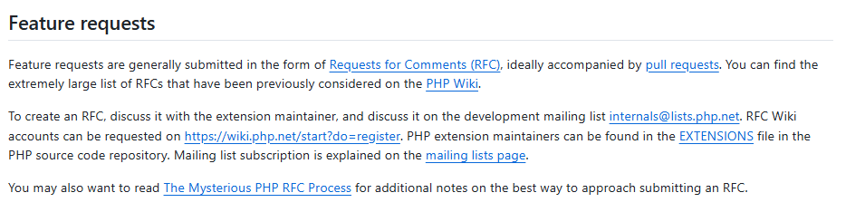
Roadmap: 6 PHP Internals - RFCs
RFCs - the process, the key
RFC: Request For Change
An RFC is ideally accompanied by pull requests, showing the change in discussion
There is a formal and structured procedure to create RFCs, as stated in “Contributing section of PHP’s repository” …

Slide 60
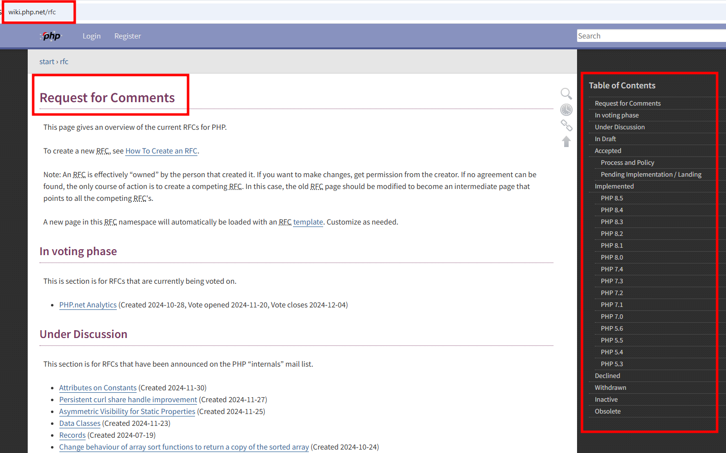
Roadmap: 6 PHP Internals - RFCs
RFCs - the process, the key
Check current RFCs and their status at: https://wiki.php.net/rfc

Slide 61
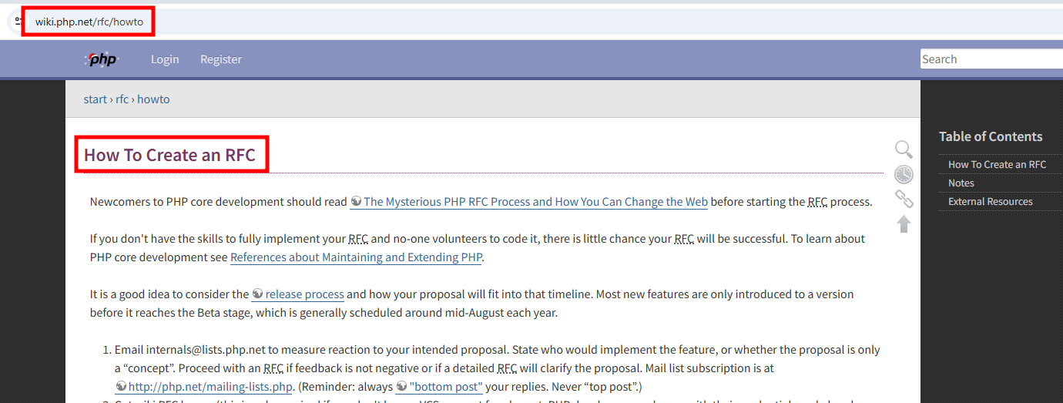
Roadmap: 6 PHP Internals - RFCs
RFCs - the process, the key
Read the full procedure to create an RFC at: https://wiki.php.net/rfc/howto

Slide 62
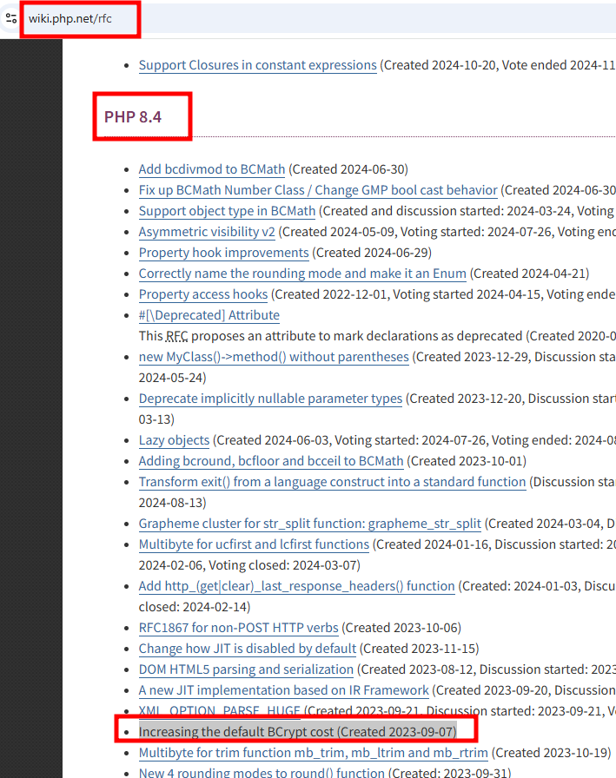
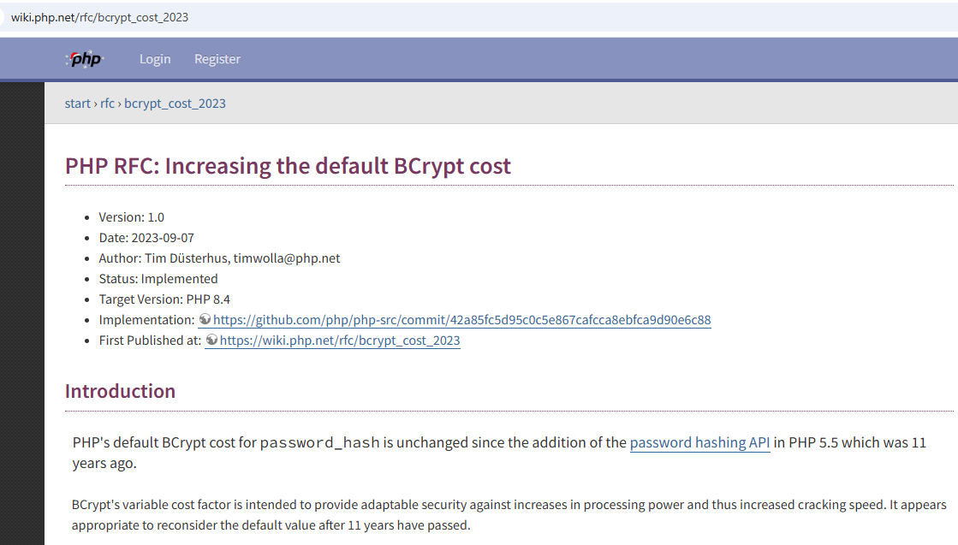
Roadmap: 6 PHP Internals - RFCs
RFCs - Simple Example

Slide 63
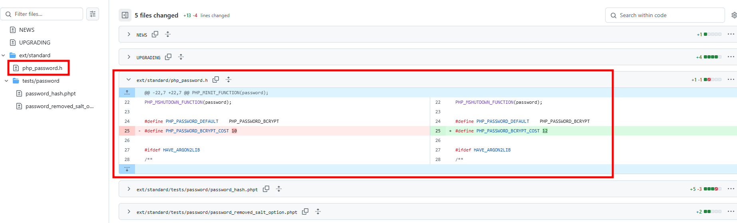
Roadmap: 6 PHP Internals - RFCs
RFCs - Simple Example

Slide 64
Roadmap: 6 PHP Internals - Extensions
Extensions
PHP has its core base extensions (extensions so fundamental that they are part of the core)
Most of then are written in C, but is also possible to use another programming languages such as C++, Rust, Go, Zig, etc.
Reasons to write are many
There are plenty of PHP’s extension on the web, mainly listed on https://pecl.php.net/

Slide 65

Roadmap: 6 PHP Internals - Extensions
Extensions
There are plenty of PHP’s extension on the web, mainly listed on https://pecl.php.net/

Slide 66

Roadmap: 6 PHP Internals - Extensions
Other resources
Zephir Programming Language
Zephir, an open source, high-level language designed to ease the creation and maintainability of extensions for PHP with a focus on type and memory safety.
https://zephir-lang.com

Slide 67

Roadmap: 6 PHP Internals - Extensions
Other resources - Zephir Programming Language

Slide 68

Roadmap: 6 PHP Internals - Extensions
Other resources - Zephir Programming Language

Slide 69

Roadmap: 6 PHP Internals - Extensions
Other resources - PHP-CPP - Extensions in C++ made easy

Slide 70
Roadmap: Internals Information
Resources:
Internals
PHP Internals Book: https://www.phpinternalsbook.com/
Book: Extending and Embedding PHP by Sara Golemon
Official
Github discussions and pull requests
Internals mailing list
Check the already created RFCs and their implementation
https://wiki.php.net/internals/extensions
https://qa.php.net/write-test.php
https://www.php.net/get-involved.php
https://wiki.php.net/rfc/howto
https://qa.php.net/write-test.php
http://doc.php.net
Extra
Use AI tools like ChatGPT
Nikita Popov https://www.npopov.com/
Extensions:
https://github.com/phplang/extension-tutorial
https://speakerdeck.com/carusogabriel

Slide 71
Roadmap: Internals Information
Resources:
Youtube:
Gina Banyard - How to contribute to PHP
Gabriel Caruso - Contribute to PHP Core
PHPKonf 2020 - Ekin Bayar: We want YOU to contribute to PHP
Gabriel Caruso: Contributing to PHP's Core – phpCE 2018
Sammy Kaye : Writing tests for PHP source
PHP Round Table

Slide 72

Last but not least! … donate! :)

